Slide 1
“Bank Loan Analysis “
By
Hemant Gupta

Slide 2

Overview
This report provides a detailed overview of the evaluation of a borrower's creditworthiness and the associated risks before a financial institution approves a loan.
This process is crucial for banks to assess the likelihood of repayment and to make informed lending decisions.
We have analyzed large number of records that includes loan amount , total payment, revolving balance, loan amount status , etc.

Slide 3
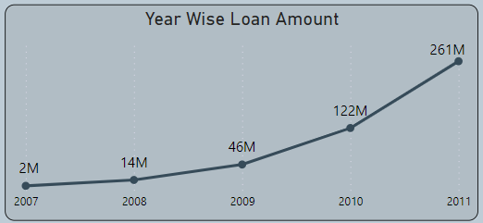
KPI 1:Year Wise Loan Amount Stats
Year-over-year (YOY) is a financial term used to compare data for a specific period of time with the corresponding period from the previous year. It is a way to analyze and assess the growth or decline of a particular variable over a twelve-month period . We can observe in the line chart ,that year over year the loan amount is continuously increasing.
The main reason for this maybe High level of consumer confidence that can lead to increased Year wise loan amount or spending and borrowing.

Slide 4
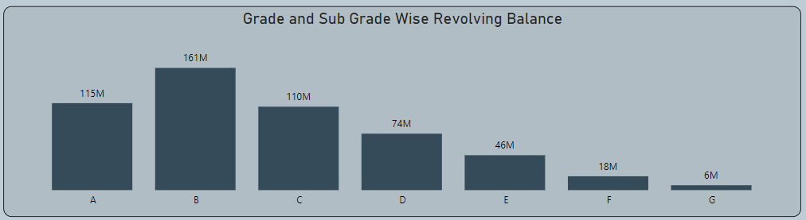
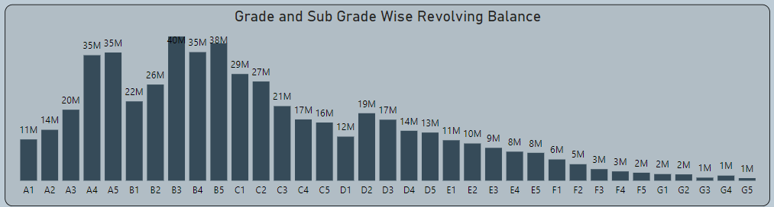
KPI 2: Grade and Sub Grade Wise Revolving Balance
The revolving balance typically represents the amount of credit card debt that a person carries from month to month. Revolving balance play a significant role in determining the credit scores.
High-income individuals generally have more financial resources, which make it easier for them to pay off their credit card balances in full each month. This financial capacity reduces the need to carry revolving balances and incur interest charges.
Low-income individuals often face tighter budget constraints, making it challenging to pay off credit card balances in full each month. As a result, they may be more likely to carry revolving balances and pay interest over time.

Slide 5
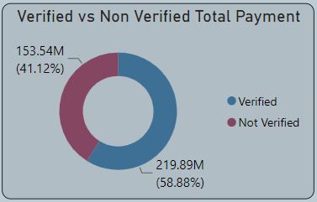
KPI 3:Total Payment for Verified Status Vs Total Payment for Non Verified Status
We can clearly see in the graph that total payment is higher for verified customers compared to non-verified customers.
Verified customers are likely to have undergone some form of identity verification, adding a layer of trust and credibility to their transactions. This trust factor may result in higher payment amounts.
Moreover, Verified customers are less likely to engage in fraudulent activities, reducing the occurrence of chargebacks for businesses.

Slide 6
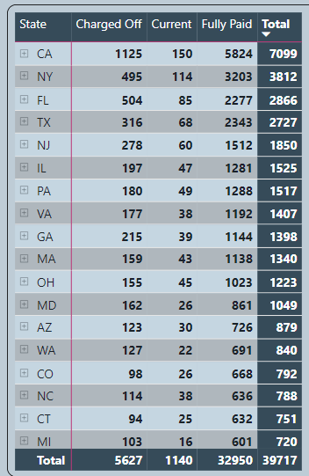
KPI 4:State-Wise and Month-Wise Loan Status
In the chart, we can observe that fully paid loan amount status is higher as compared to charged off. A higher proportion of loans being "fully paid" indicates that borrowers in the state are generally financially stable and capable of meeting their repayment obligations. This may be influenced by factors such as the state's economic conditions, employment rates, and overall financial health of the population.
The affordability of loans, influenced by interest rates and loan terms, may contribute to successful loan repayment. If loans are structured in a way that aligns with borrowers' financial capacities, it can lead to higher rates of full repayment.

Slide 7
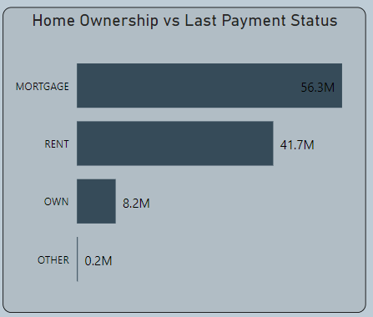
KPI 5:Home Ownership Vs Last Payment Date Status
In the data we can clearly see that higher payment is paid for mortgage home ownership, Higher mortgage payments may be associated with properties in more desirable or expensive locations.
Increased demand for housing can drive up the need for mortgages, contributing to higher overall loan demand . In the case of mortgages, the demand for housing and fluctuations in the real estate market can affect the size of home loans. Rising property values can lead to larger loan amounts.

Slide 8
Conclusion
When people are optimistic about the economy, they may be more willing to take on debt for purchases such as homes, cars, and other goods.
In the case of mortgages, the demand for housing and fluctuations in the real estate market can affect the size of home loans. Rising property values can lead to larger loan amounts.
Rising demand for debt consolidation may also indicates challenges within the overall financial health of the population, so to overcome this possibility promote financial literacy and responsible lending practices may be beneficial.
Cultural attitudes towards debt and financial management, as well as social trends, can influence the willingness of individuals to seek debt consolidation as a solution to their financial challenges.
It is essential to note that while debt consolidation can be a helpful tool for managing debt, but it may not be suitable for everyone, so the underlying causes of increasing loan demand should be carefully examined to address broader financial and economic issues.

Slide 9

Thank You

